Slide 1
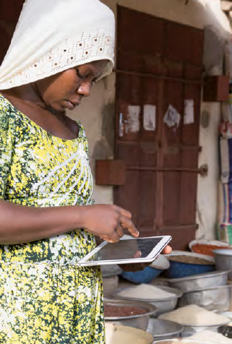
From Bits to Bites ICTs in Food Security and Nutrition Programmes
Dr Veronica Tuffrey
SNRD Working Group
Food Security, Nutrition and Resilience
Webinar, 18 June 2020

Slide 2
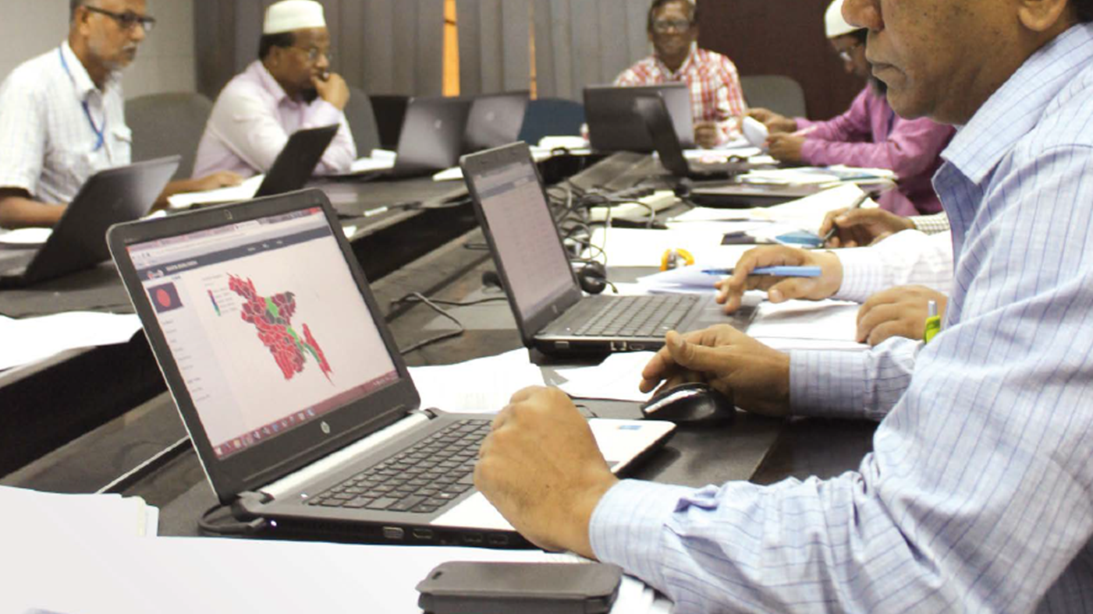
“…the computer is the most remarkable tool that we’ve ever come up with.
It’s the equivalent of a bicycle for our minds.”
Steve Jobs, 1980

Slide 3
Content
Evidence review of applications of digital technology to improve nutrition
Background
Method
Findings
Challenges and success factors

Slide 4
Background
4.1 billion people (more than half global population) were using internet at end 2019
Uneven technology growth – in Africa ICT use is much lower than rest of world
Adoption of technology can help drive reductions in poverty and inequality
GIZ would like to better harness ICT to address poor nutrition

Slide 5
Growth in ICTs globally, 2001-2019*
Growth in ICTs globally, 2001 – 2019
Source: International Telecommunication Union

Slide 6
Percentage of households with internet by region, 2019 Source: International Telecommunication Union

Slide 7
Methods
Desk-based review of academic and grey literature over past ten years
Also incorporated 2018 survey on use of DTs in GIZ nutrition projects
Searched institutional websites (eg FAO, UNICEF, USAID, WFP)
and databases (eg Pubmed, Science Direct, Web of Science)
Used Google to identify relevant government sites, organization and interest groups sites, and specialist blogs
Selected use-cases of ICT in nutrition-specific and -sensitive projects

Slide 8
Terms used, and scope
Information
and
Communication
Technologies
Digital Technologies
ICT v. DT: The term ICT includes a
wider range of technology than the term DT
e-Nutrition: “The improvement of nutrition through use of ICT”.
e-Nutrition involves the conceptualization, design, development, evaluation and application of innovative ways to use ICT in nutrition
Nutrition activities: address determinants of foetal and child nutrition and development
Nutrition-specific: address the immediate determinants e.g. food and nutrient intake, caregiving and infectious diseases
Nutrition-sensitive: address the underlying determinants e.g. food security, caregiving resources, access to health services and a safe and hygienic environment AND incorporate specific nutrition goals and actions

Slide 9
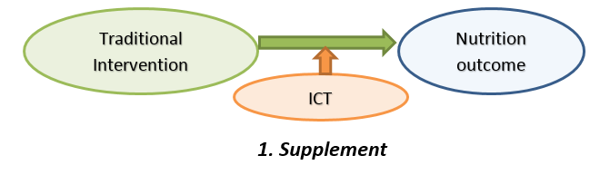
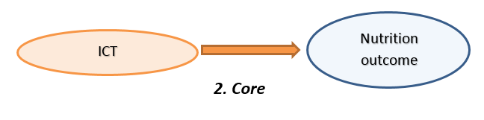
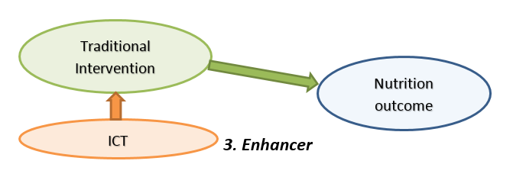
Three roles of ICT for enhancing effectiveness of nutrition-related activities

Slide 10
Nine domains of e-Nutrition
Individual assessment and diagnostics
Surveillance, early warning and programme planning
Monitoring and evaluation of programmes
Data collection
to assess, monitor
and plan
Advocacy and fundraising
Information and education for nutrition personnel
Information and education for the public
Communication
to inform, train and motivate
Service delivery and records' management
Financial transactions and incentives
Promoting links, especially for supply chain management
Administration
to connect, pay and
deliver services

Slide 11
Findings - GIZ
GIZ is very active in two domains:
2) Monitoring and evaluation
e.g. digital dashboard in India
4) Information and education for the public
e.g. Telephone hotline in Malawi
GIZ is also active in:
1) Individual assessments and diagnostics - app to calculate micronutrient intake
3) Surveillance, early warning and planning – mapping projects and indicators in Yemen
5) Information, education and decision-support of nutrition personnel – e-learning platform for nutrition workers, and Network for Information on Climate Change in India
7) Promoting links - website links producers with wholesalers in Cameroon
8) Financial transactions - supporting government administration of PDS in India

Slide 12
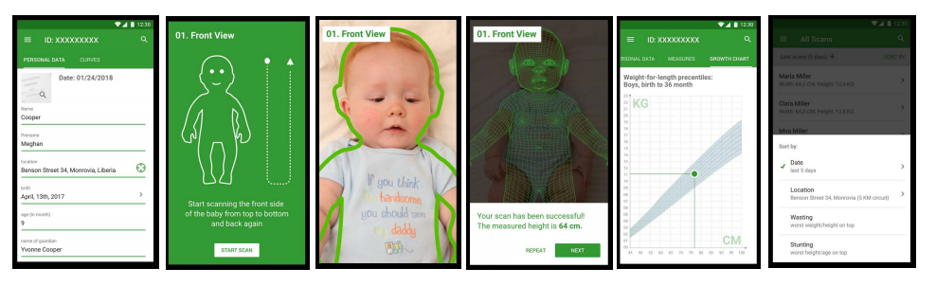
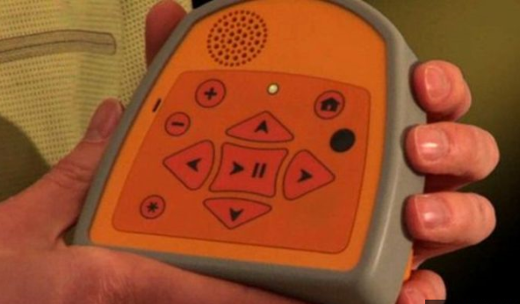
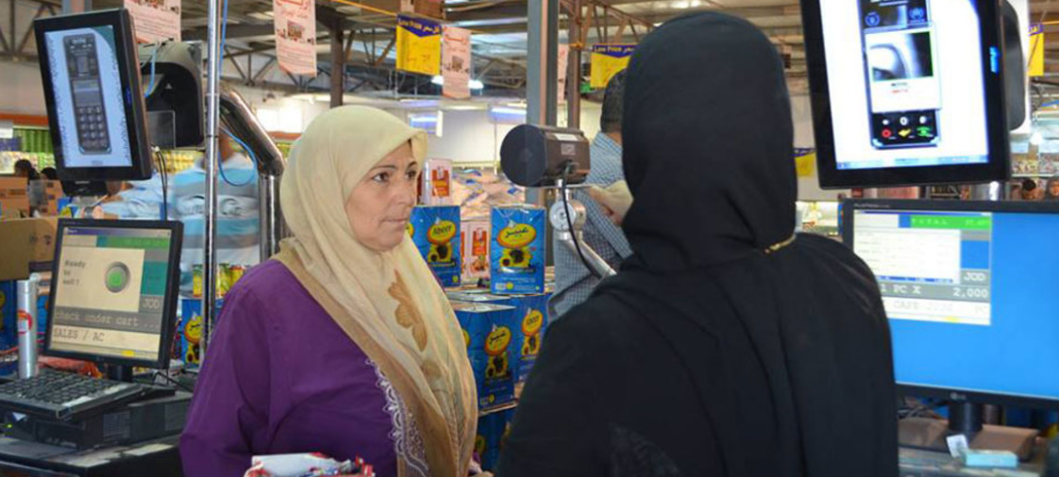
Findings – Other agencies Wide range e.g. Child growth monitor app, “Talking Book” and Iris scan camera

Slide 13
Examples of suggestions for future GIZ activities
Data collection to assess, monitor and plan
Adopt field-friendly methods for anthropometric and micronutrient assessment
Incorporate nutrition outcomes reinforced by ICT into social protection and WASH programmes
Use nutrition modelling tools
Communication to inform, train and motivate
Use wider range of technologies e.g. uni- and bi-directional SMS messages
Create internal online forum for discussion, sharing experiences and distributing information about use of ICT
Administration to connect pay and deliver services
Develop apps to link farmers for sharing information and experiences
Incorporate biometric and blockchain technology into software to enable secure transactions

Slide 14
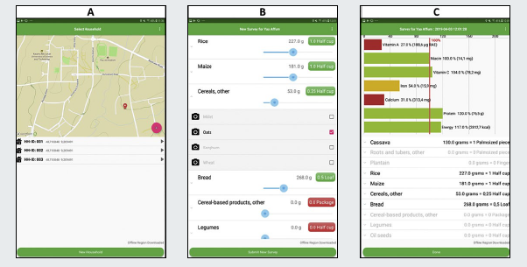
Challenges include
Capability
Sustainability
Equity of access
Poor quality / contradictory advice
Lack of evidence of effectiveness

Slide 15
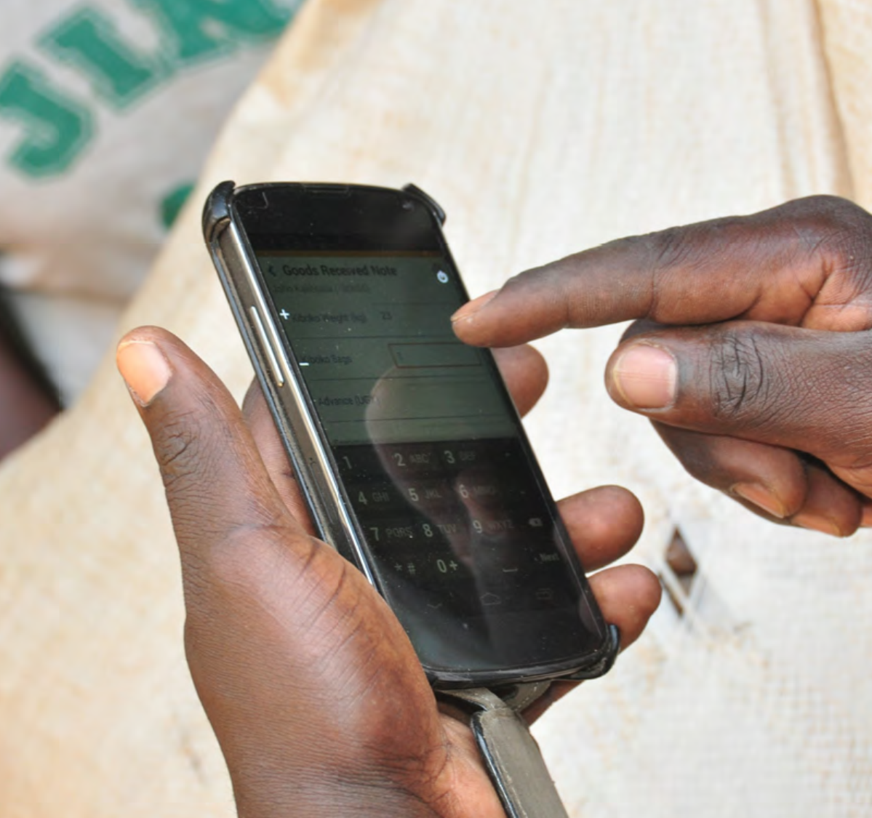
Seven success factors
Content
Capacity development
Gender and diversity
Access and participation
Partnerships
Technologies
Sustainability

Slide 16
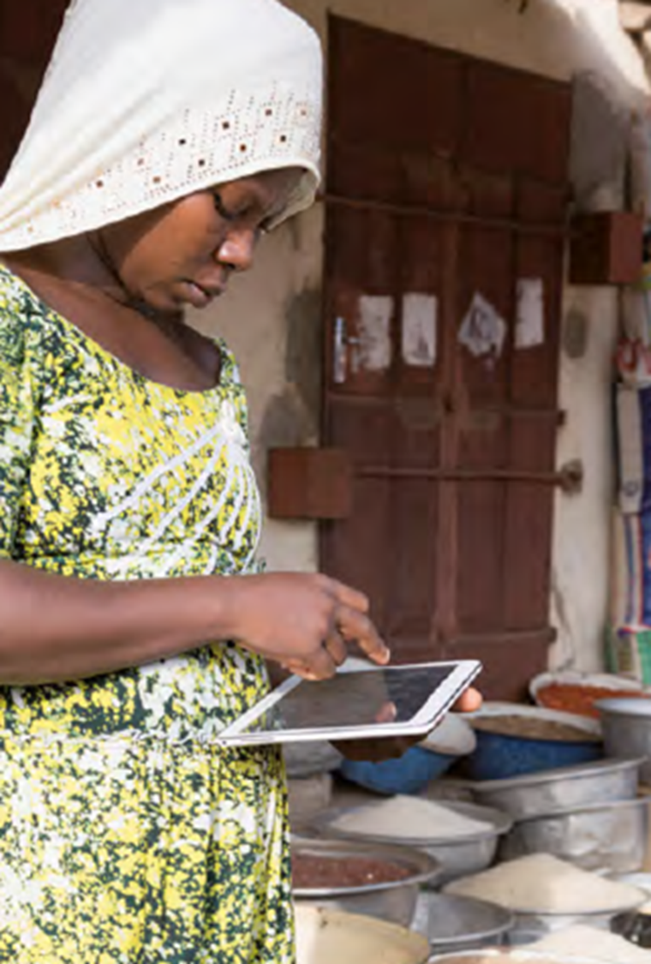
“Improved nutritional status is essential for sustainable development.
We are all responsible for ensuring that actions and investments truly respond to the realities of those for whom the multiple burdens of malnutrition are not an abstract concept, but an everyday reality.”
Dr David Nabarro, Global Nutrition Report, 2014

Slide 17
Thank you

